Slide 1
NGO Donations Tracking Application
Presented By :
1. Santosh Biradar
2. Mohan Yadav
3. Yash Lonkar
4. Aniket Gadekar
Guided by
Mrs. Kiran Tiwari

Slide 2
Aim :Empowering Users to Support Causes.
Design the application to handle an increasing number of users, NGOs, and donations.
To enable users to easily contribute to NGOs and charitable causes.
To ensure transparency in financial transactions and donation utilization by allowing NGOs to submit detailed reports.
Empower NGOs by providing a platform for them to register, showcase their work, and efficiently manage donations.

Slide 3
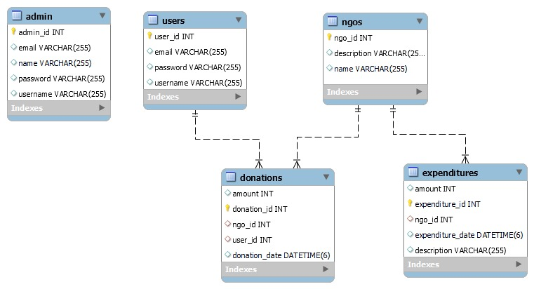
ER Diagram :

Slide 4
Entities in the System :
User : Represents registered users of the application.
2. NGO : Represents registered Non-Governmental Organizations.
3. Donation : Captures details of user contributions.
4. Expenditure : Contains information submitted by NGOs on fund utilization.
5.Admin : To perform administration operations.

Slide 5

Relationships Between Entities:
User and Donation:
One-to-Many relationship: A user can make multiple donations.
Donation and NGO :
Many-to-One relationship: An NGO can accept multiple donations.
NGO and Expenditure:
One-to-Many relationship: An NGO can make multiple expenditures.

Slide 6





Technologies Used :
Spring Boot for Backend
Angular for Frontend
Postman for Backend Testing
MySQL Database
Razorpay Payment Gateway

Slide 7
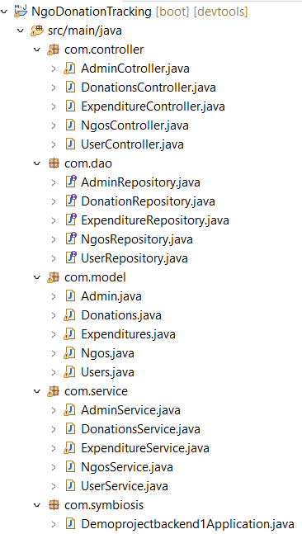
Project Backend Architecture in SpringBoot :
Controller Layer: To handle incoming requests, interact with services, and return responses.
Service Layer: Responsible for implementing business logic.
Repository Layer: To access and manage data .
Model : on which all the POJO classes of the entities are designed.
Spring Boot Application: The main application responsible for handling requests, managing business logic, and interacting with the database.

Slide 8

API Testing :
Postman is used to test the backend API. To create requests for various functionalities such as user registration, donation processing, etc.
HTTP Request Methods for testing :
GET : Retrieving data from the server.
POST: Creating new data.
PUT : Updating existing data.
DELETE : Removing data.

Slide 9
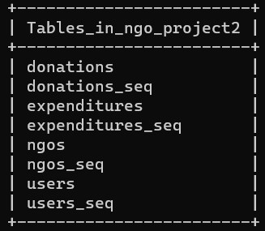

Database :
Created MySQL databased :

Slide 10
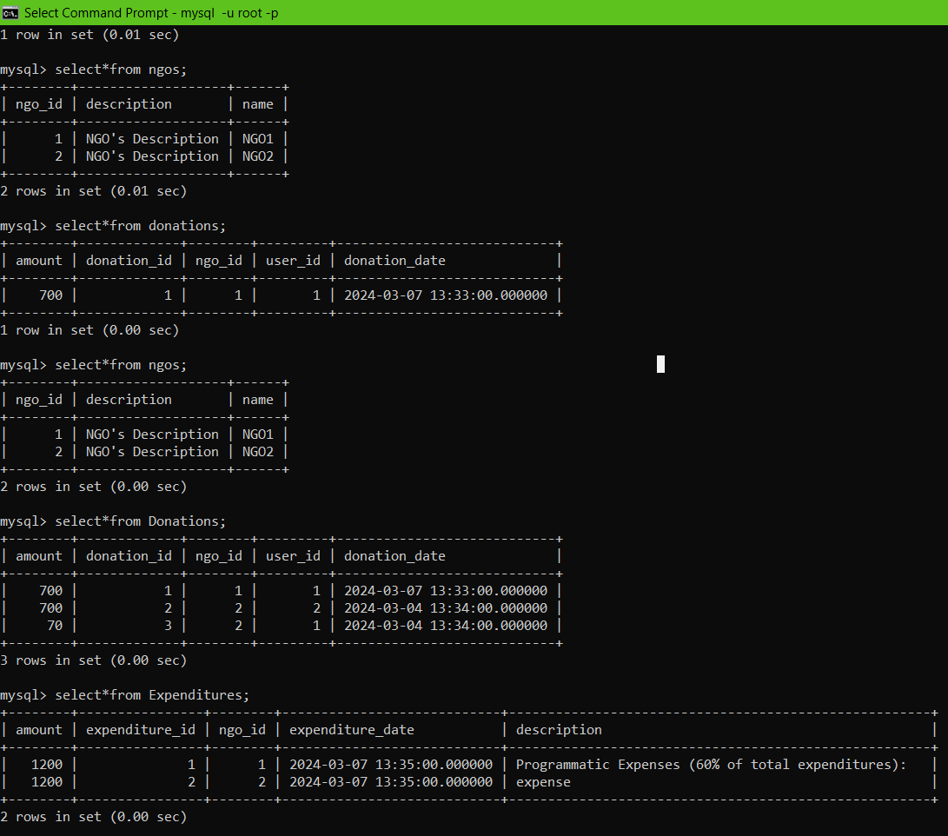

Slide 11
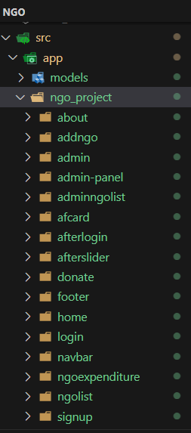
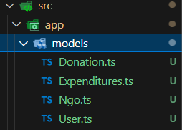
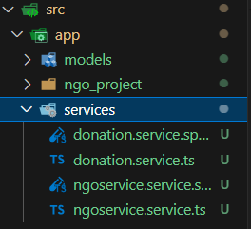
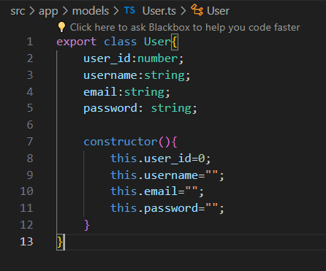
Project Frontend Architecture in SpringBoot :

Slide 12
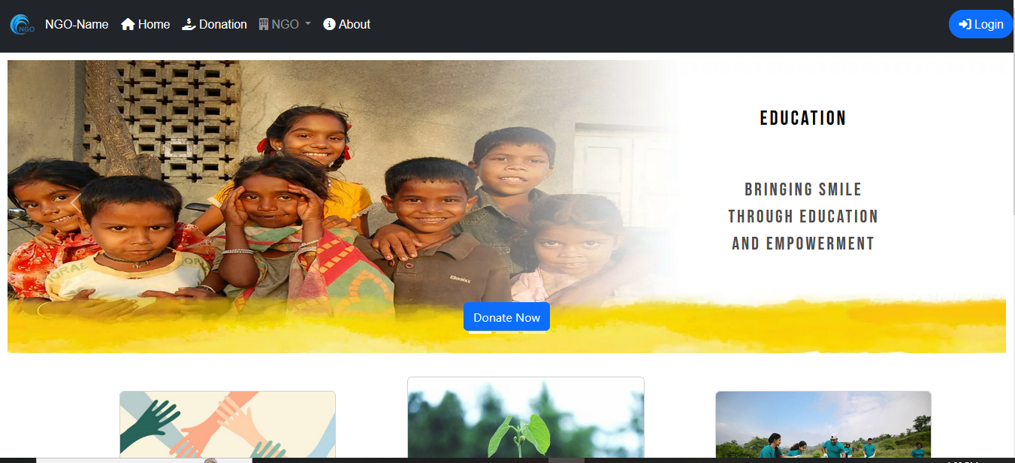
Home Page :

Slide 13
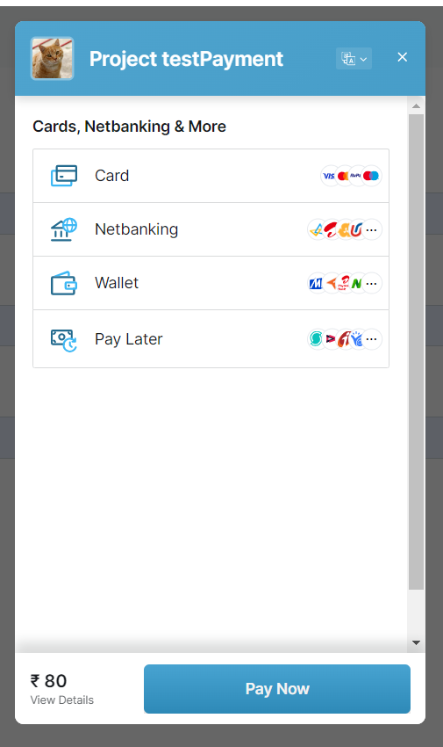
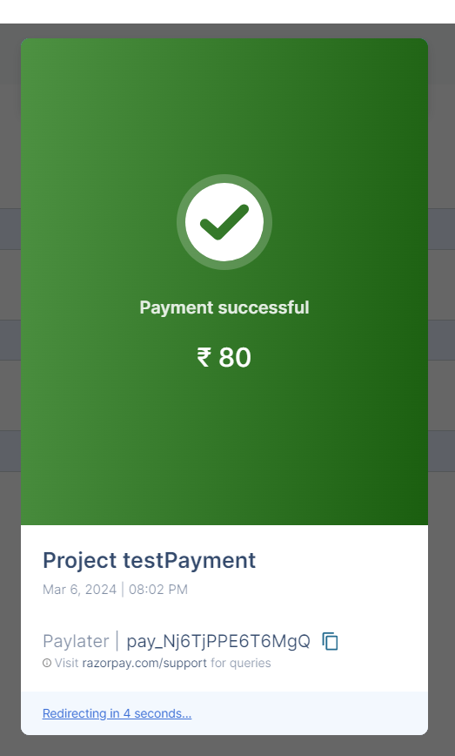
Razorpay Payment Gateway in Test Mode :

Slide 14
Key Features :
Simplified the process of introducing new features or enhancements.
Secure user authentication and registration process.
Accept donations through various payment methods, including credit cards, UPI, and more.
Transparent tracking of fund utilization.

Slide 15
Future Upgrade :
Allow users to link their mobile wallets for quick and convenient donations.
Implement support for cryptocurrency donations, providing users with alternative ways to contribute.
Provide personalized donation recommendations or campaigns tailored to individual users, increasing engagement.
Implement feedback mechanisms to gather insights from users on potential improvements and features.

Slide 16
Conclusion :
The user can choose the NGO of their preference and make a donation to them through this system. The user will be able to see the list of transactions to ensure that their money is utilized in a rightful manner. Users can also check the data for any signs of manipulation.
To maintain security within the system, the Admin has been given the sole right to add NGOs. Admin can also check whether any data has been tampered with or manipulated.

Slide 17


